Slide 1

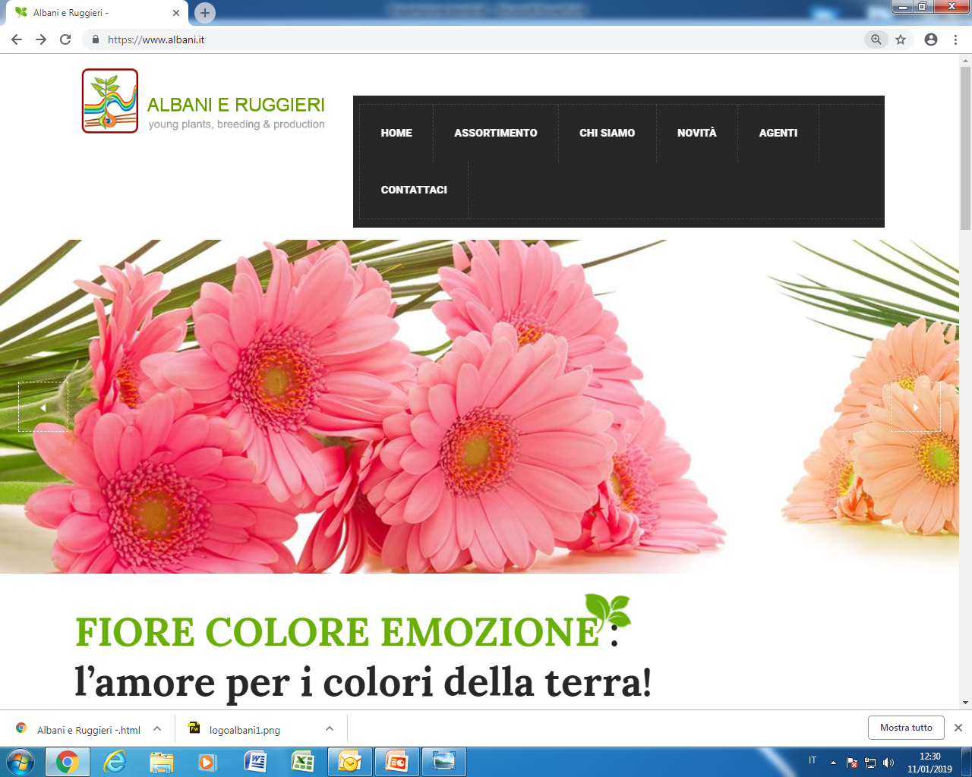
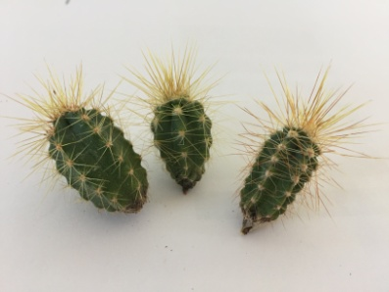
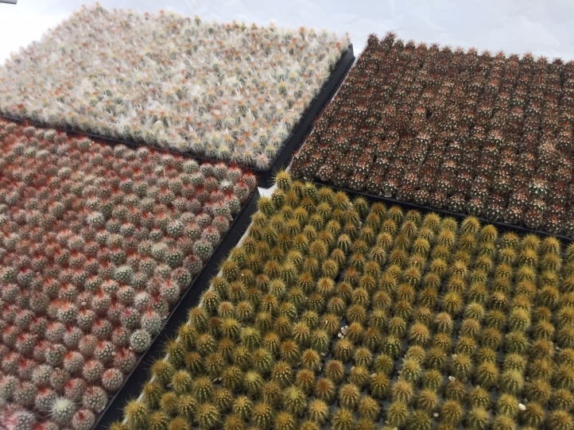

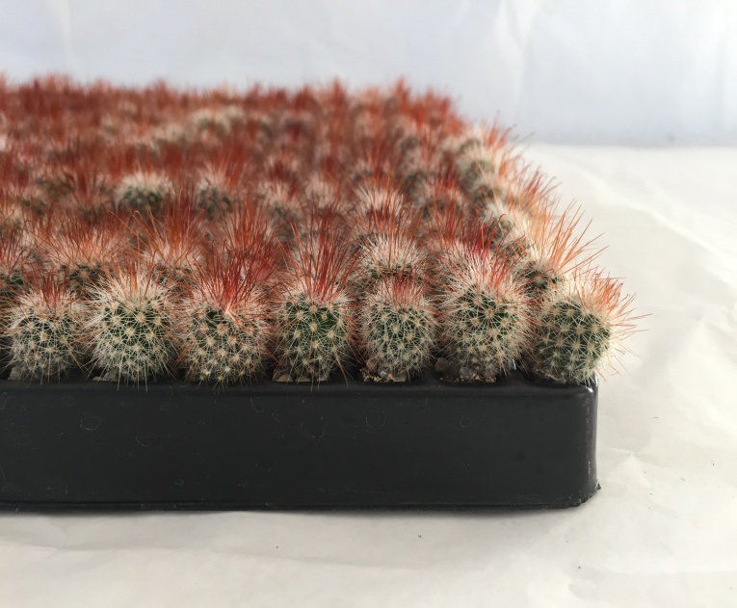
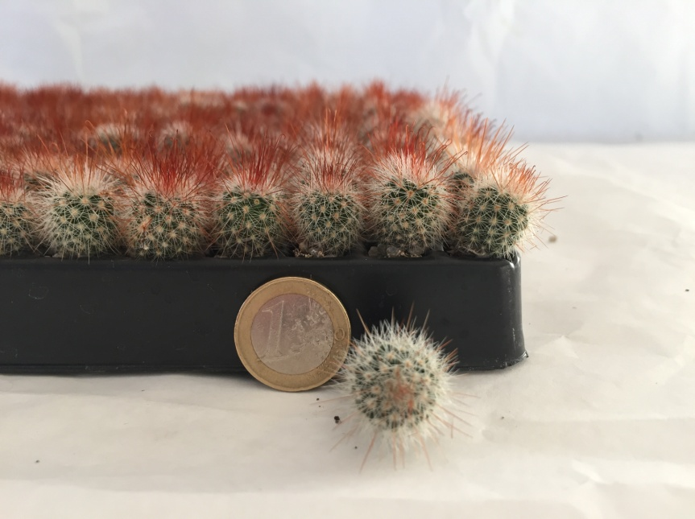
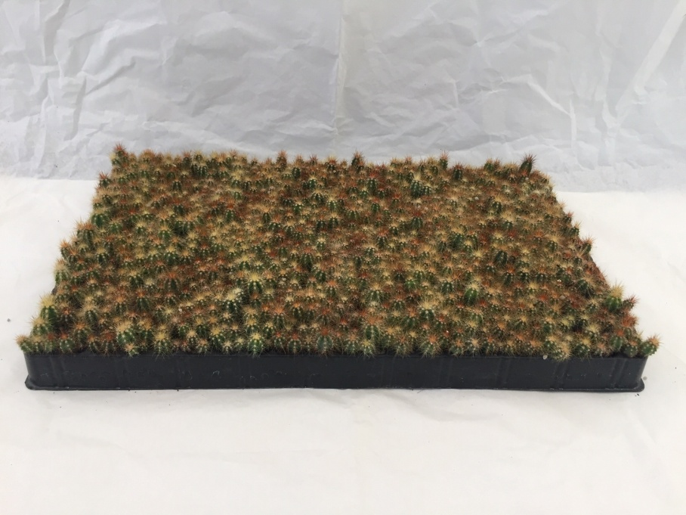
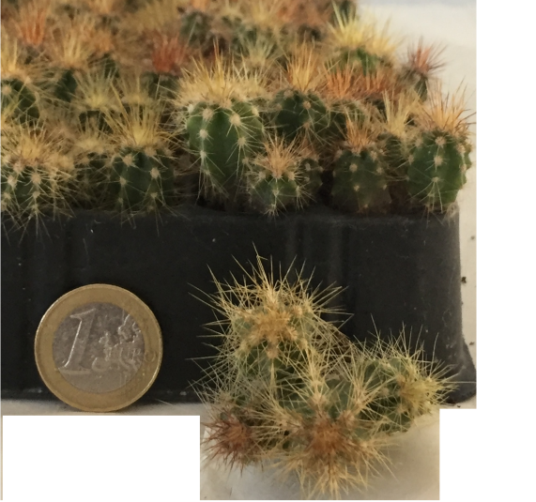
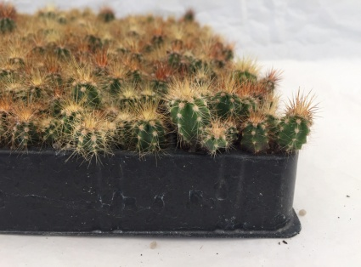
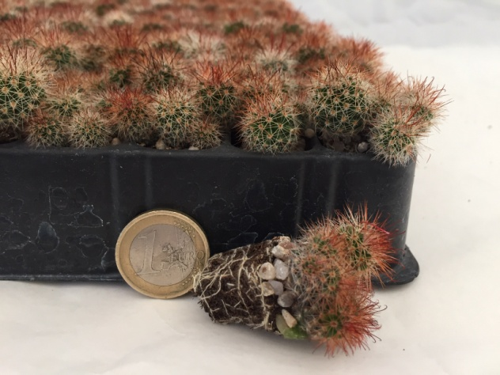
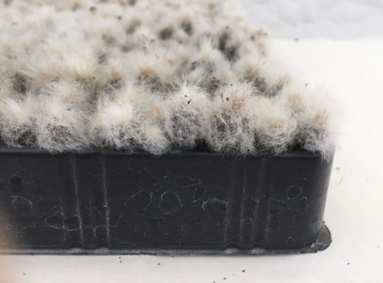
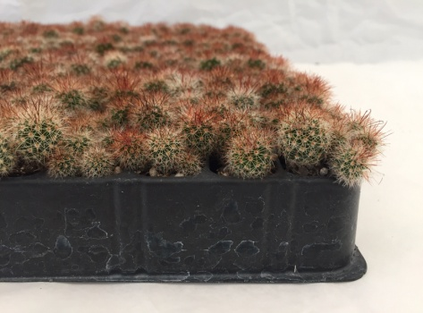
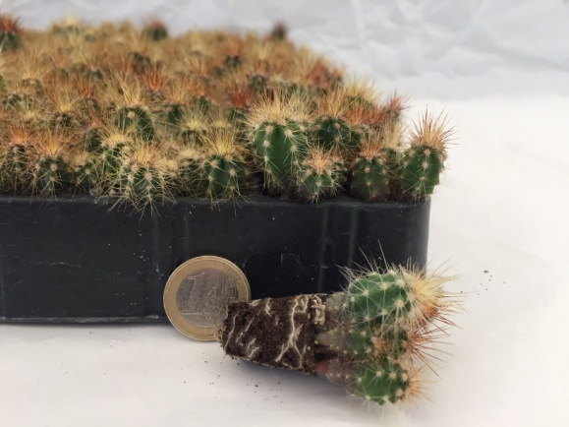
Seedling Cactus
Ø 1.2 mm single 540 holes in tray
NO roots shipping is available
1 CC = 80 trays/43.200 plants
1 box= 3 trays
1 pallet= 60 boxes/ 180 trays/97.200 plants
Ø 2.5 mm group 252 holes in tray
1 CC = 80 trays/20.160 plants
1 box= 2 trays
1 pallet= 60 boxes/ 120 trays/30.240 plants
Contact Info
Email:
marina@albani.it
Phone:
+39 (0) 766 568 401

